Slide 1
Predicting hard disk failure at the delta center in the netherlands
Carmen adriana martinez barbosa

Slide 2
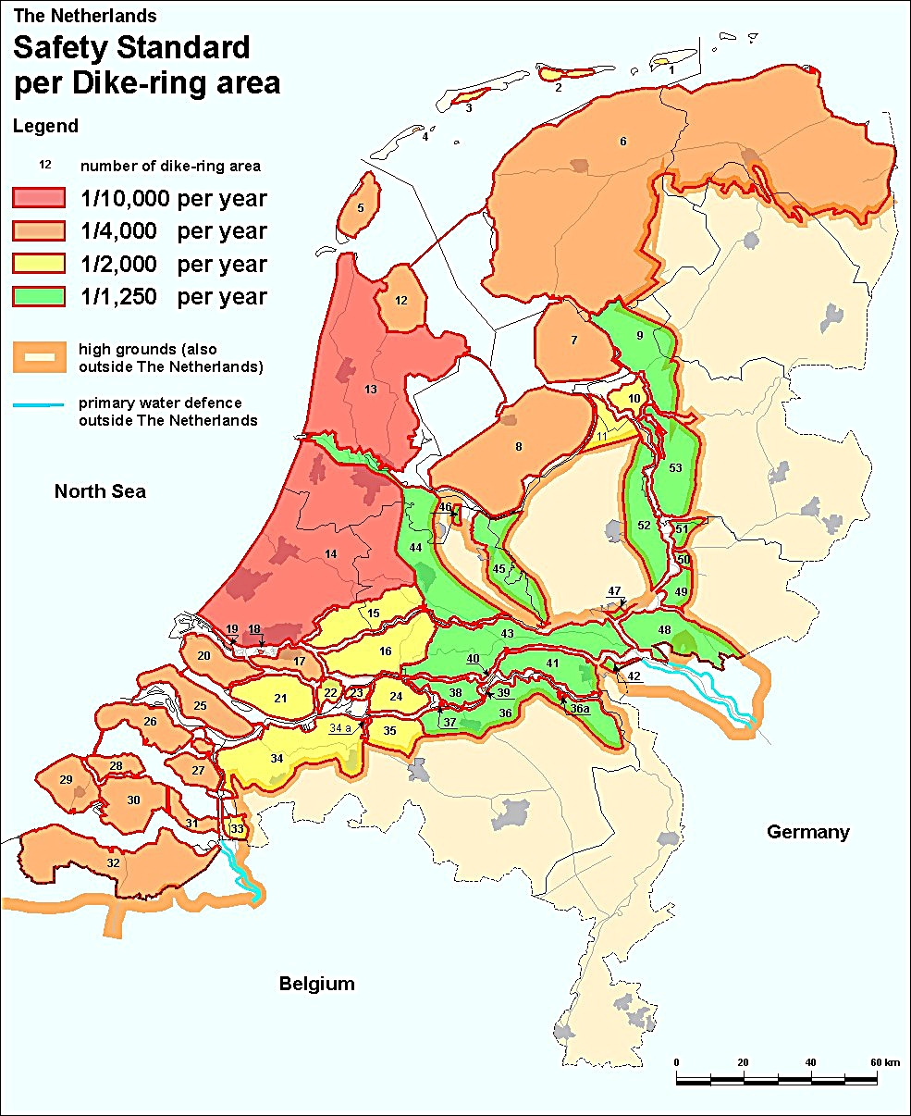
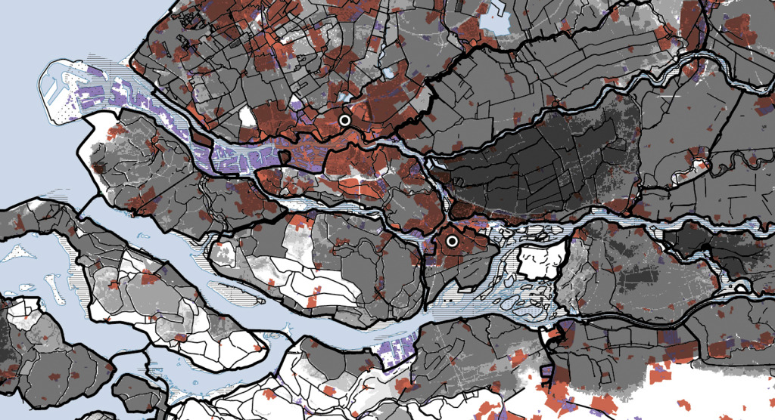
A country below the sea level
Around 60% of surface area in the Netherlands is below the sea level
To prevent overflow, an admirable system of artificial beaches, sand dunes and dikes have been built .
Dutch Hydraulic system

Slide 3
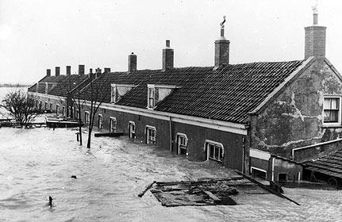
Dutch hydraulic system
Currently, the Netherlands has 700 km of dikes which are divided in 53 dike areas.
The Dutch hydraulic system is controlled by supercomputers which monitor the status of the dikes. This control is made 24 hours all days of the year.
A failure in one of the hard disks of the supercomputer, would produce devastating effects leading to a flood that could destroy large part of the western region of the country.
Dutch flood in 1953. Thousands of people and animals died as a result of the collapse of the dikes’ structure.

Slide 4
Aim of the project
Predicting the hard disk that fail during the first week of 2016 at the Delta center in the Netherlands.
For this I will analyze the information of thousands of hard drives collected during the year of 2015

Slide 5
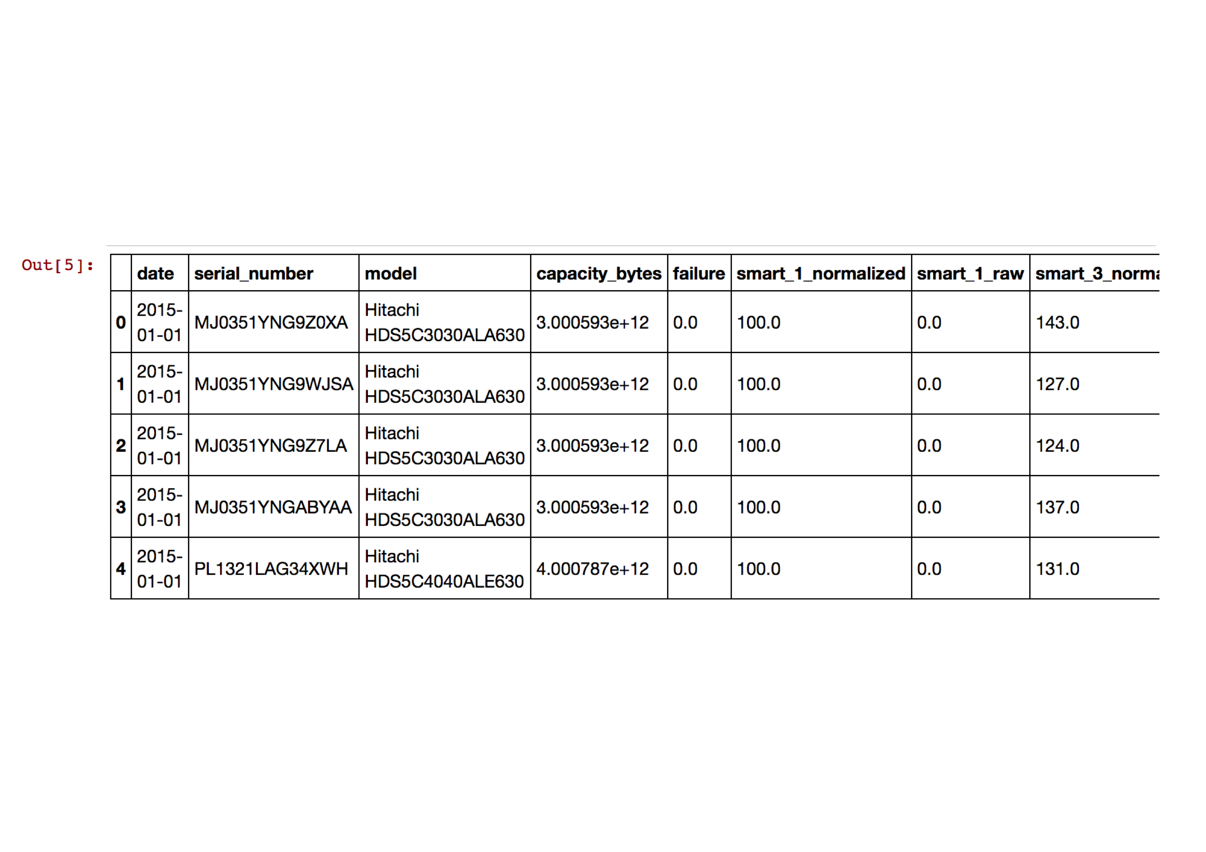
The dataset
Data provided by the Backblaze center which contains information of 62800 hard drives.
This dataset contains date, serial number, model, capacity bytes, a flag showing whether a disk fails or is still working and 90 columns corresponding to different SMART attributes of the disk.
In the analysis I will use six attributes only: Read error rate (SMART 1); spin-up time (SMART 3); Reallocated sector counts (SMART 5); running time (SMART 9); power cycle count (SMART 12) and internal temperature (SMART 194). These attributes have normalized and raw values. I will use both.

Slide 6
What do data tell us?
Most of the hard disk have a failure rate smaller than 0.4
There are three models which have failure rates higher than 0.5:
- ST1500DL003
- ST320005XXXX
- WDC WD 1600BPVT
The last model have an age of 2 years. Therefore, the delta center should not purchase this type of hard disk (poor quality).

Slide 7
The dataset can be classified in two groups:
1. Working disks -> disks that still work after one year of measurements (97% of data).
2. Failed disks -> disks that fail before or during December of 2015 (2% of data).
UNBALANCED CLASSIFICATION PROBLEM
For the prediction, I have to use techniques to BALANCE the classes
As a first step I evaluate the distributions of failed and working disks for each of the SMART attributes.

Slide 8
Statistical analysis of the distribution of failed and working disks
The SMART attributes for which the distribution of failed and working disks are different are (with a confidence of 1%):
Error rate
Bad Sector count
Spin-up time.
Are these SMART attributes important for the prediction of hard disk failure?

Slide 9
Note the differences between the distributions of failed and working disks.

Slide 10
Predicting the failed disks at the delta center in the Netherlands.
Before modeling the data, it is important to choose the most important features that predict the failure of hard disks.
I used an ensemble of decision trees, to account for non-linear relationships.
The most important features are:
Reallocated sector counts (normalized values)
Reallocated sectors counts (raw values)
Read error rate (normalized).

Slide 11

Predictive model
Splitting of the data into:
Train set -> 70% of the total dataset
Test set -> 30% of the total dataset
Tactics to balance the classes:
1. Oversampling -> I increased the minority class such that
failed/working= 2/3
2. Subsampling -> I decreased the majority class such that
failed/working = 2/3
3. Bagging: subsampling the majority class multiple times and averaging the predictions of the model.
Model used for the prediction:
Random Forest with:
N_estimators=200
Min_samples_leaf= 5
Max_depth= 10

Slide 12
How good is the model?
Oversampling
method
Subsampling
method
Bagging
method
True positives= 174 disks
True negatives= 16945 disks
False negatives=1502 disks
False positives= 249

Slide 13
Conclusions
The Delta center should not purchase hard drives of model WDC WD 1600BPVT , since more than 50% of them fail before 2 years of operation.
According to the model, 174 hard disks will fail during the first week of 2016 at the Delta center in the Netherlands. It is necessary to use a better model and more SMART attributes to increase the precision in the prediction.

